Slide 1
EMPLOYEE MANAGEMENT SYSTEM using FILES
By
Samuel Erra (ID: 8097395)
Nagesh Rupnar (ID: 8097450)
Murugan Vinayagam (ID: 8097456)
Naga Devika Kongala (ID: 8097413)

Slide 2
PROBLEM STATEMENT
To insert Employee information, Department information and Project information and retrieve data by using following algorithms for Employee Management System.

Slide 3
ALGORITHM : Insert Employee Info
Step 1: Start.
Step 2: Set all the data.
Step 3: Check if file.length = = 0.
YES – Add the data in file.
NO –
Set flag = False.
Read the data from file.
Iterate data until EOF.
If line.contains(e.empid.ToString())
YES –
Take any number from line.
Check data == empid.
Yes- set flag = true &
Display “can’t store”
Check flag == False
Call writer class and write the data in file & display “stored”.
Step 4: End.

Slide 4
Insert Department Info
Step 1: Start.
Step 2: Set all the data.
Step 3: Check if file.length = = 0.
YES – Add the data in file.
NO –
Set flag = False.
Read the data from file.
Iterate data until EOF.
If Department.getDepartmentID().ToString()
YES –
Take any number from line.
Check data == deptid.
Yes- set flag = true &
Display “can’t store”
Check flag == False
Call writer class and write the data in file & display “stored”.
Step 4: End.

Slide 5
Insert Project Info
Step 1: Start.
Step 2: Set all the data.
Step 3: Check if file.length = = 0.
YES – Add the data in file.
NO –
Set flag = False.
Read the data from file.
Iterate data until EOF.
If line.contains(p.pid.ToString())
YES –
Take any number from line.
Check data == pid.
Yes- set flag = true &
Display “can’t store”
Check flag == False
Call writer class and write the data in file & display “stored”.
Step 4: End.

Slide 6
Search all Employees using Dept name
Step 1: Start.
Step 2: id=0 & take dept name.
Step 3: Check file length= 3,
YES-
Iterate the data
Check if line.contains(name)
Check if line.contains(id)
Yes –
Display the data of ID.
No –
File is empty.
Step 4: Stop.

Slide 7
Search all projects by employee ID
Step 1: Start.
Step 2: Take Manager ID from user.
Step 3: Check if file.length! = 3.
Yes –
Read the data from file.
Iterate data & check until the EOF.
Check if line.contains(mid)
YES - Take only number from string
Read the data of dept file.
Iterate until EOF.
Check if line.contains(newd)
YES – Display details.
v. Read the data of employee file.
vi. Check line.contains(newd)
YES – Display details.
No –
File is empty.

Slide 8
Print projects based on Department name
Step 1: Start.
Step 2: Take Manager ID from user.
Step 3: Check if file.length! = 3.
Yes –
Read the data from file.
Iterate data & check until the EOF.
Check if line.contains(mid)
YES - Take only number from string
Read the data of dept file.
Iterate until EOF.
Check if line.contains(pid)
YES – Display details.
v. Read the data of employee file.
vi. Check line.contains(pid)
YES – Display details.
No –
File is empty.

Slide 9
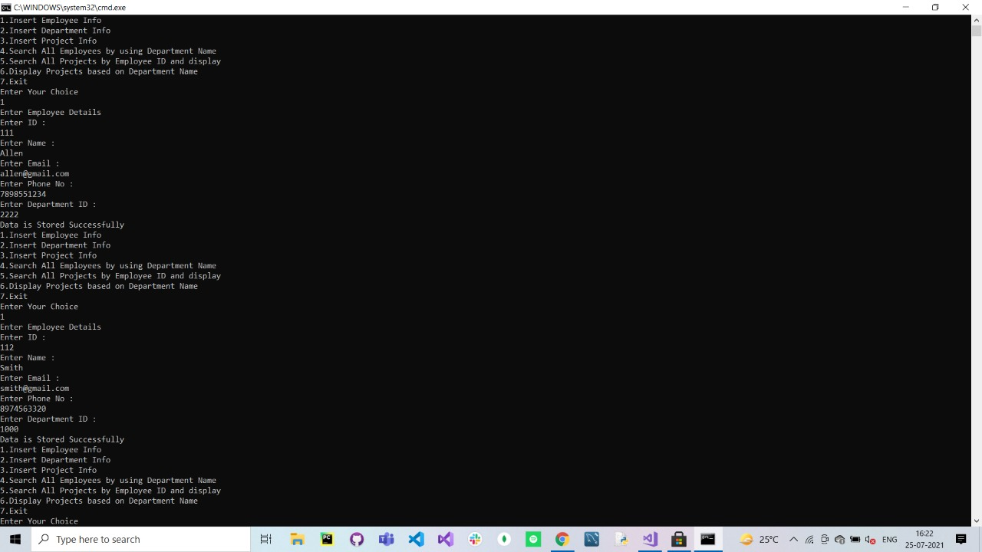
OUTPUTS

Slide 10
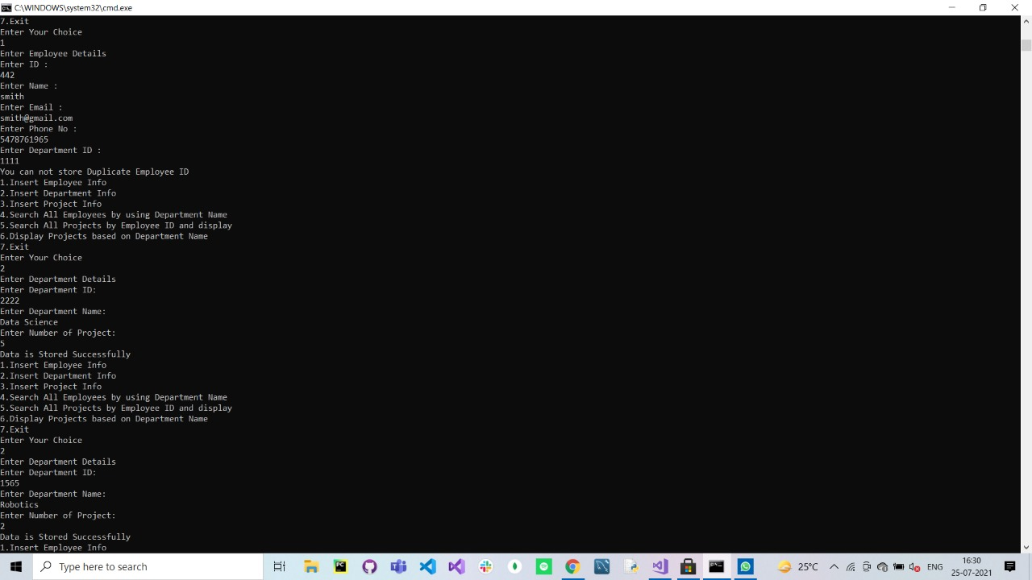

Slide 11
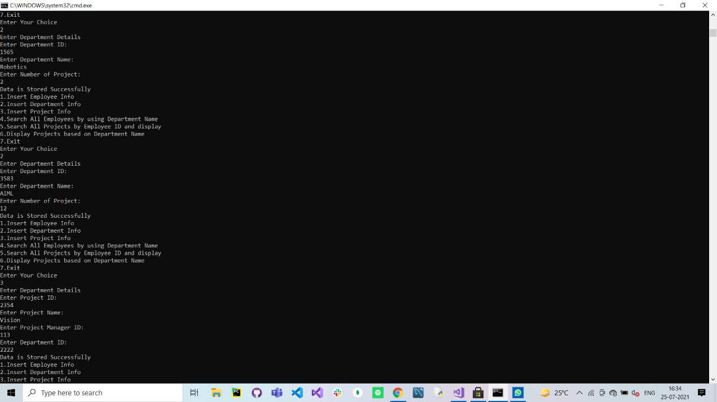

Slide 12
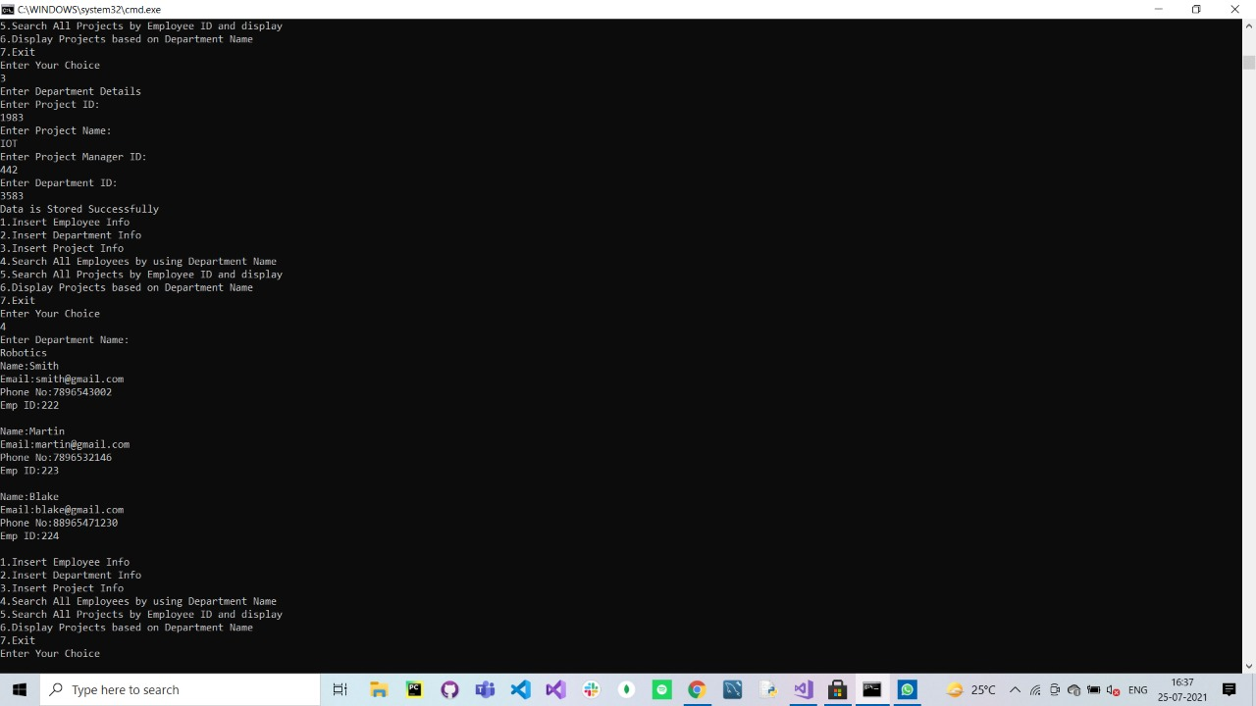

Slide 13
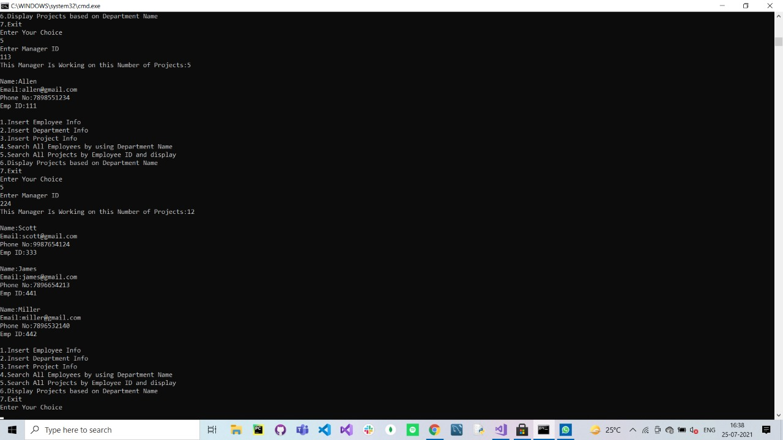

Slide 14


Slide 15
THANK YOU!

